Slide 1

Credit Card
Fraud Transactions
By: Raka P. N.

Slide 2
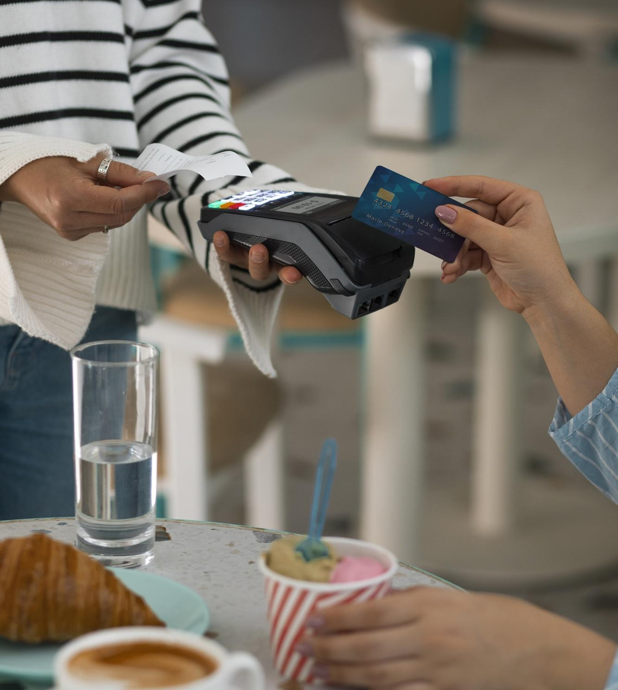
Project Workflow
Business Understanding
1
2
Data Understanding
3
Data Exploration
4
Data Visualization
5
Data Insight

Slide 3
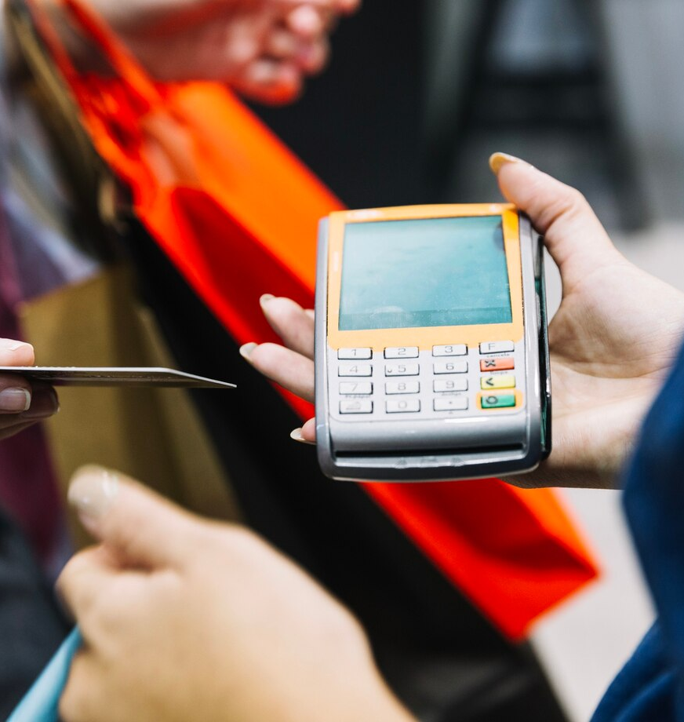
Business
Understanding

Slide 4

Company Background
Company ABC, faces challenges with their existing fraud detection system. The current system exhibits slow responsiveness in recognizing new patterns of fraud, leading to significant financial losses. To address this issue, they have contracted us to design and implement an algorithm that can efficiently identify and flag potentially fraudulent transactions for further investigation.

Slide 5

Problem Statement
What are the key indicators used to determine whether a transaction is fraudulent or not?
In which regions do fraudulent transactions occur?
How accurate and efficient is the model in distinguishing fraudulent and non-fraudulent transactions, and what metrics are used to evaluate its performance?

Slide 6
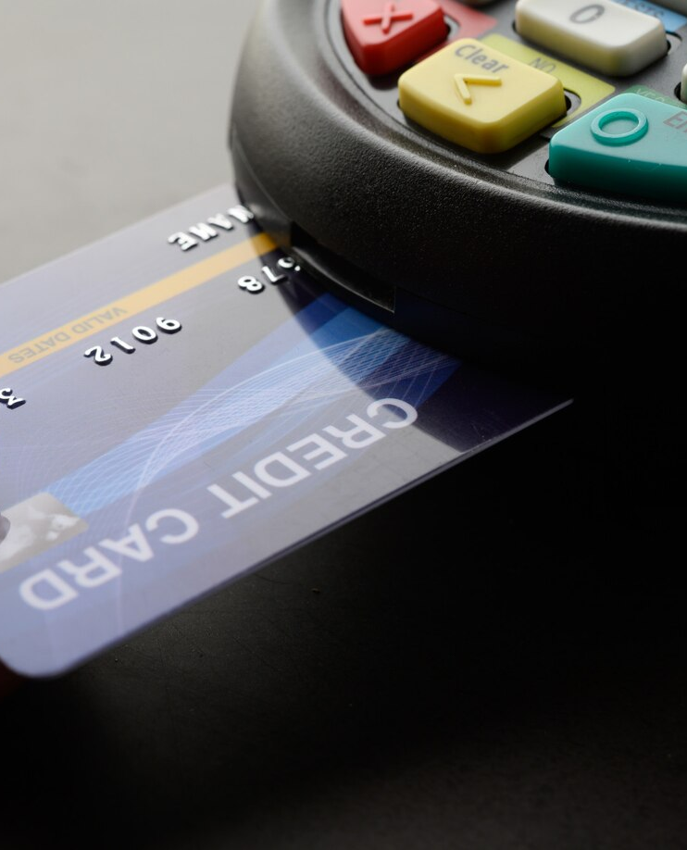
Data
Understanding

Slide 7

Origin of Data
The data used comes from ABC company in .csv format, consisting of two main files:
cc_info.csv, which contains general information about credit cards and cardholders.
transactions.csv, which records details of credit card transactions from August 1 to October 30.

Slide 8
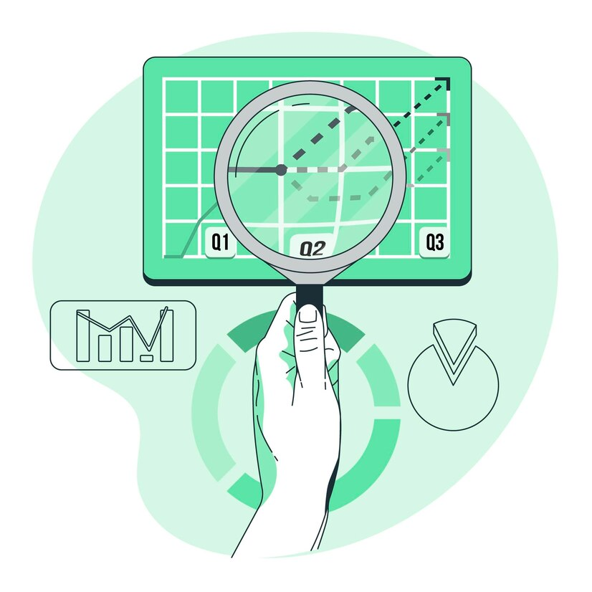
cc_info.csv
Total Row: 984, Column: 5
No | Column Name | Description | Data Type
1 | credit_card | List of Credit Card ID | Integer
2 | city | Credit Card Town Location | String
3 | state | Credit Card State Location | String
4 | zip code | Credit Card Zip Code Location | Integer
5 | credit_card_limit | Credit Card Limit Transactions | Integer

Slide 9
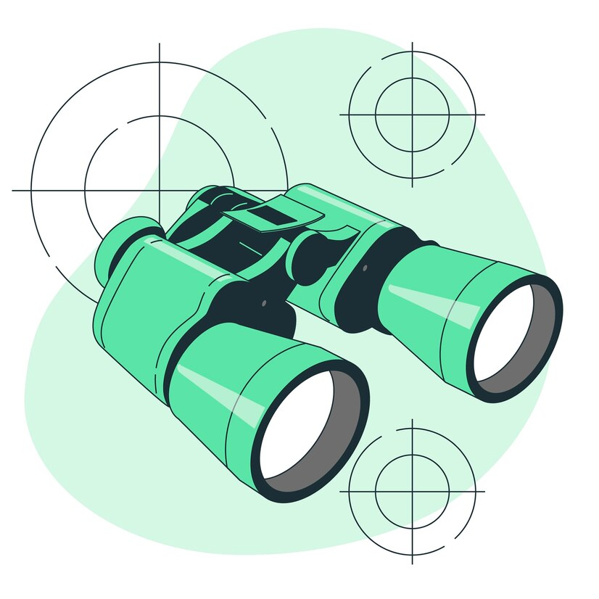
transactions.csv
Total Row: 294588, Column: 5
No | Column Name | Description | Data Type
1 | credit_card | List of Credit Card ID | Integer
2 | datetime | Transactions Timestamp | Date
3 | transaction_dollar_amount | Total Transactions | Float
4 | long | Geography Longitude Location | Float
5 | lat | Geography Latitude Location | Float

Slide 10

Data
Exploration

Slide 11









Working Project Tools
Packages Used
Programming Language
Visualization

Slide 12




Data Workflow
Data Mart
Origin / Raw Data
Processing Data
Data Modeling

Slide 13
Data Processing

Slide 14
Data Processing
1
Combine Dataset
2
Null Checking
3
Duplicate Checking
4
Data Enrichment
5
Data Filtering
6
Data Structuring
7
Outlier Checking
8
Split Data: 1. Datamart 2. Modeling

Slide 15
Data Mart

Slide 16

Credit Card Info
No | Column Name | Description | Data Type
1 | credit_card | List of Credit Card ID | Integer
2 | city | Credit Card Town Location | String
3 | state | Credit Card State Location | String
4 | zip code | Credit Card Zip Code Location | Integer
5 | credit_card_limit | Credit Card Limit Transactions | Integer

Slide 17

Credit Card Transactions
No | Column Name | Description | Data Type
1 | credit_card | List of Credit Card ID | Integer
2 | date | Transactions Timestamp | Date
3 | transactions_dollar_amount | Total Transactions | Float
4 | Long | Geography Longitude Location | Float
5 | Latitude | Geography Latitude Location | Float

Slide 18
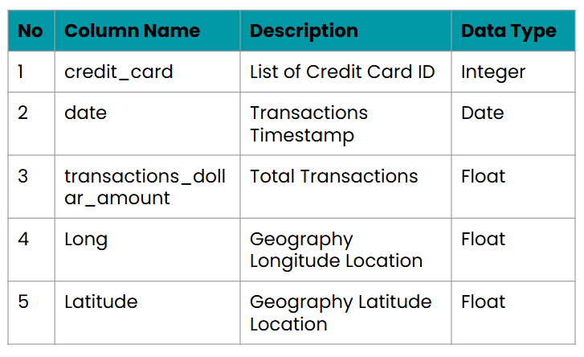
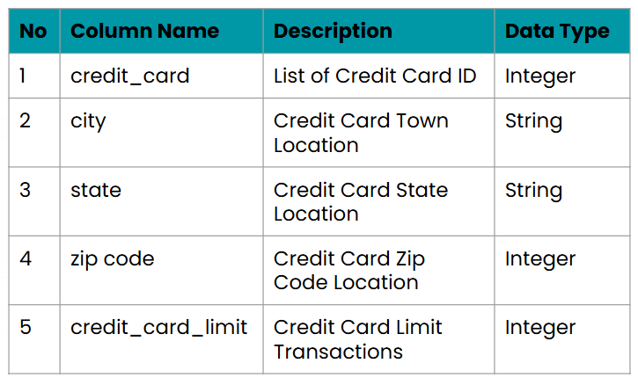
Data Schema

Slide 19
Data Modeling

Slide 20
Data Modeling
1
Check Imbalanced Data
2
Check Noise Data
3
Split Data
4
Data Resampling
5
Check Data Leak
6
Pipeline Blueprint
7
Model Tuning
8
Model Visualization

Slide 21
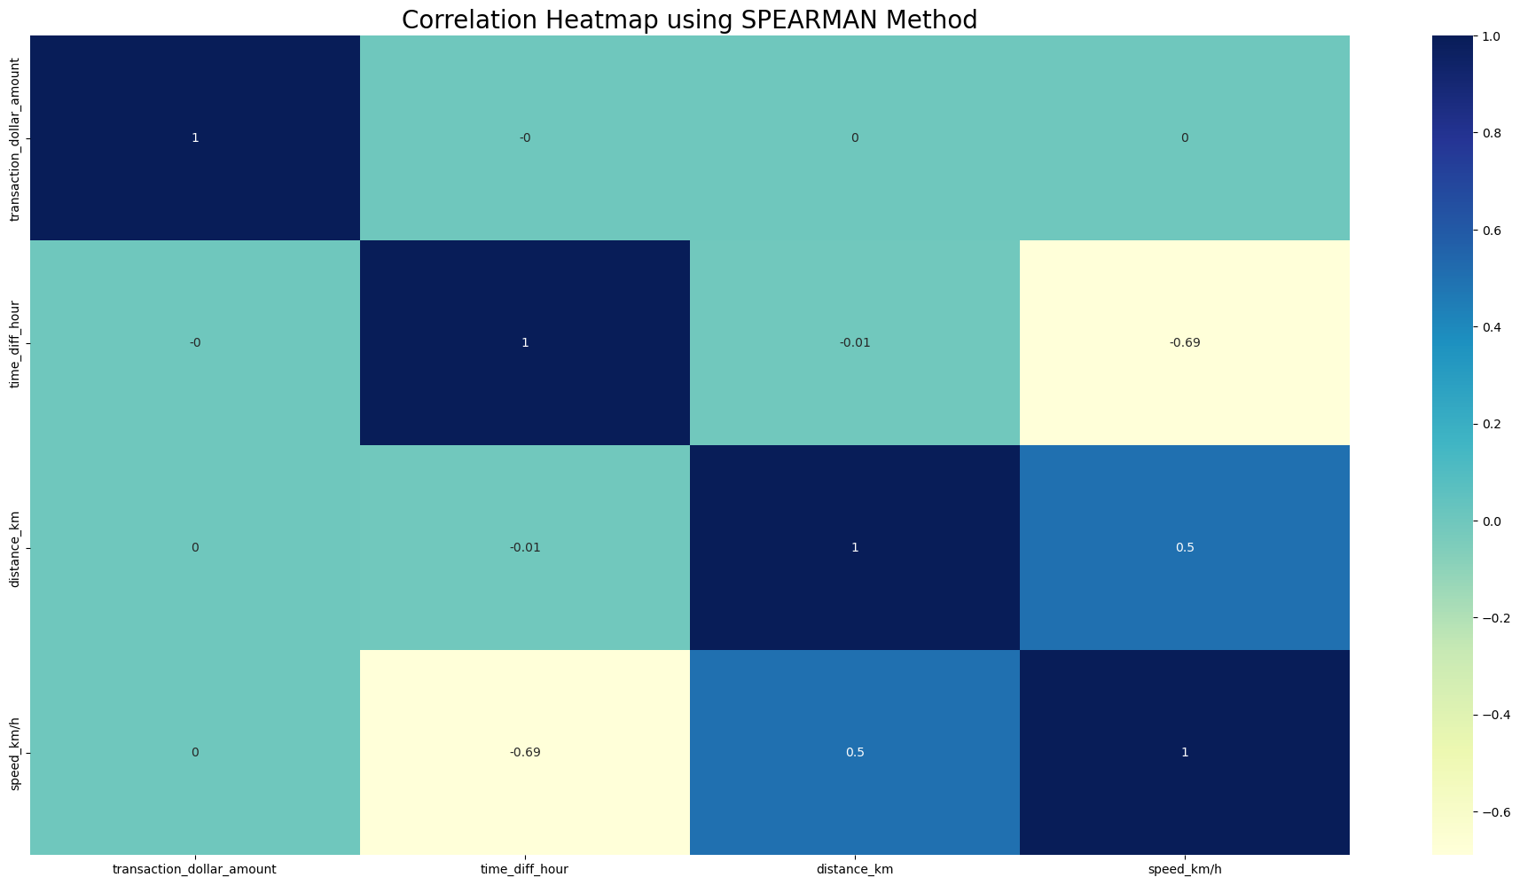
Data Overview
The correlation analysis reveals a strong negative relationship between time_diff_hour and speed_km/h tends to decrease. This could indicate that longer transaction gaps are associated with slower movements, possibly due to waiting times or extended idle periods.
There is a moderate positive correlation between distance_km and speed_km/h, meaning that longer travel distances are generally associated with higher average speeds, which could reflect more direct or faster routes for longer journeys.

Slide 22

Data
Visualization

Slide 23
Fraud Key Indicators

Slide 24
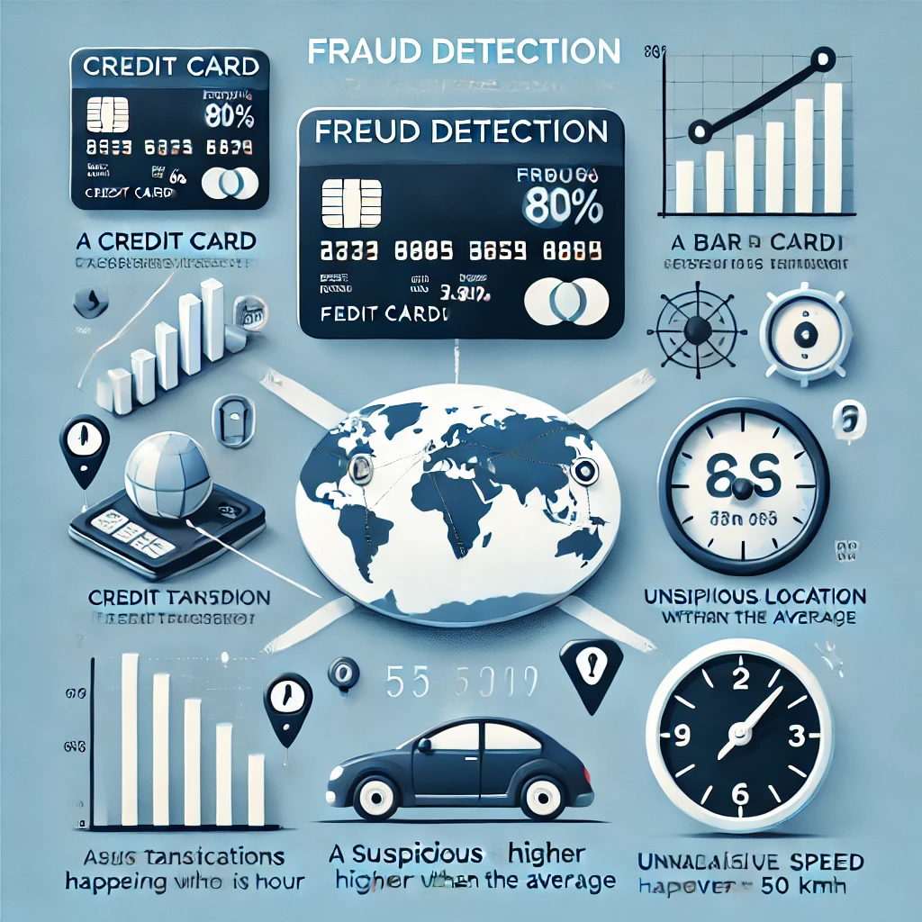
Fraud Key Indicators
A transaction is considered suspicious if its value exceeds 80% of the credit card limit, or 5 times greater than the average user transaction. In addition, the location of the transaction is also a risk factor, especially if it occurs in a high-risk zone. Some other factors that are taken into account are:
High transaction frequency: If two transactions occur in less than an hour, this could be an indication of unusual activity.
Unusual travel speed: If the movement of the transaction location shows a speed of more than 50 km/h, the transaction has the potential to be fraudulent.

Slide 25
Regions Often Do Fraud

Slide 26
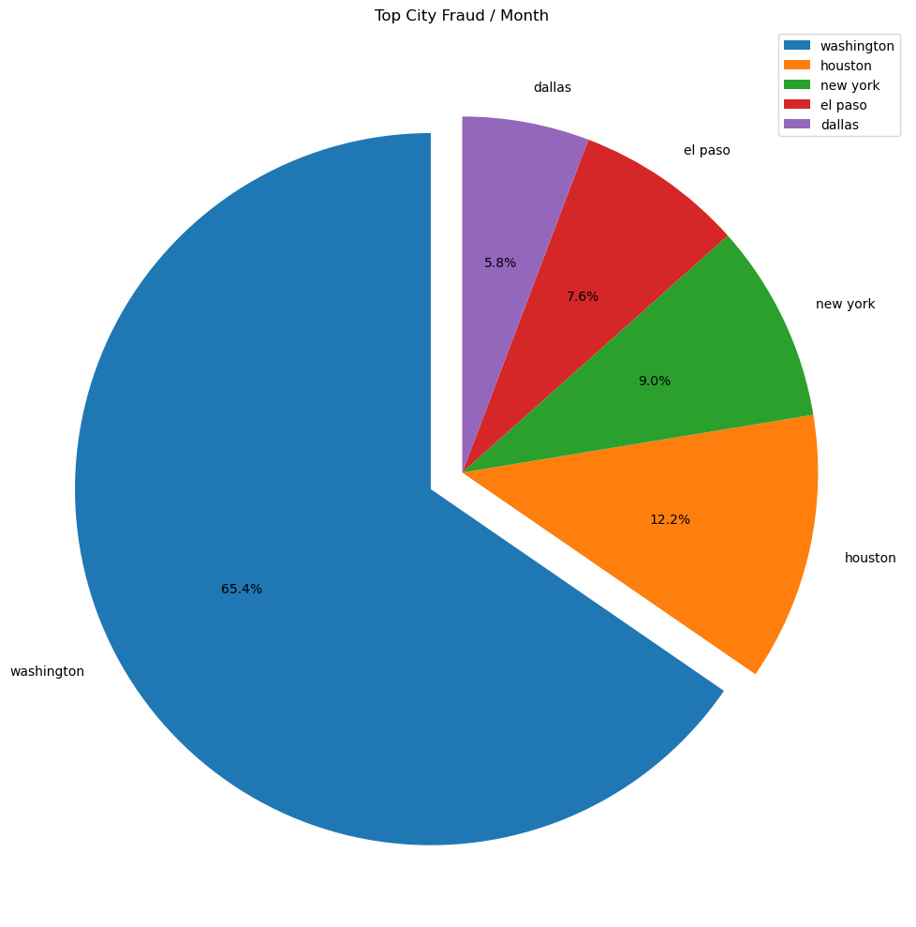
Regions Often Do Fraud
Washington was the leading center for fraud transactions with 65.4% of the total cases, significantly higher than Houston (12.2%) and New York (9.0%).
This spike indicates a recurring fraud pattern or security gap that needs to be addressed immediately.
Further investigation is needed to identify triggers, such as the type of transaction and the characteristics of the perpetrator.
With such a high level of fraud, Washington should be a top priority in implementing prevention strategies, including the use of machine learning for early detection and more effective mitigation.

Slide 27
Model Evaluation

Slide 28
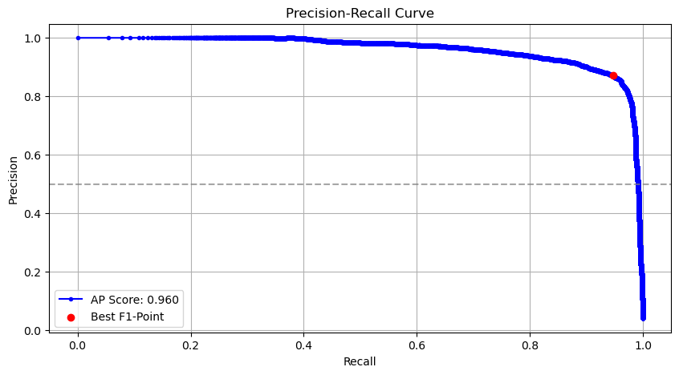
Evaluation by Precission Recall Curve
The Precision-Recall curve shows that the model performs very well in detecting fraud, with an AP Score of 0.960 indicating a high balance between precision and recall.
Precision remains stable at various levels of recall, indicating the reliability of the model in identifying fraudulent transactions without many false positives.
The best point (Best F1-Point) shows the optimal balance between precision and recall. However, as recall approaches 1.0, precision drops drastically, indicating an increase in false positives. Further optimization can be done by adjusting the threshold or applying cost-sensitive learning according to business needs.

Slide 29
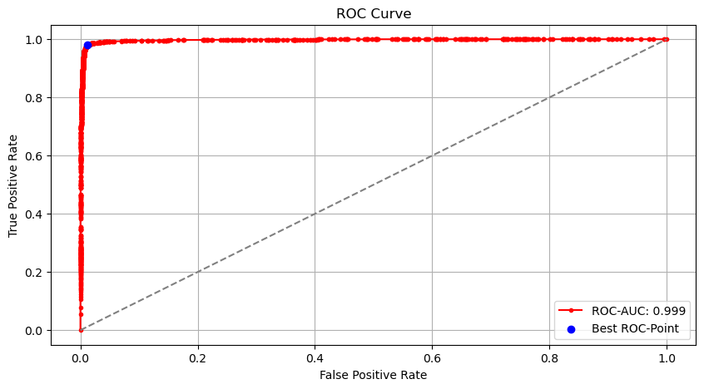
Evaluation by ROC Curve
ROC plot shows a very high performance of the classification model, with an AUC of 0.999, which is almost perfect in distinguishing positive and negative classes.
The curve that is close to the upper left corner indicates a high True Positive Rate (TPR) and a low False Positive Rate (FPR), indicating accurate detection with minimal errors.
The best ROC-point (blue dot) marks the optimal threshold for balancing sensitivity and specificity. The distribution of red dots along the curve shows stable model performance at various thresholds, well above the random baseline (AUC = 0,5).

Slide 30
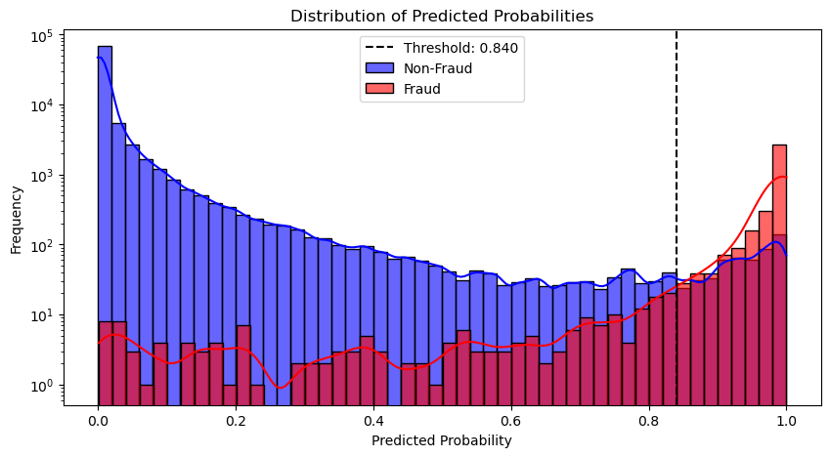
Evaluation by distribution model’s predictions
The majority of non-fraud (blue) has a low probability, while fraud (red) is concentrated at high values.
The threshold of 0.840 (dashed line) is the model’s decision limit in classifying fraud. The model is able to separate the two classes, but there is still overlap, which can lead to false positives or false negatives.

Slide 31
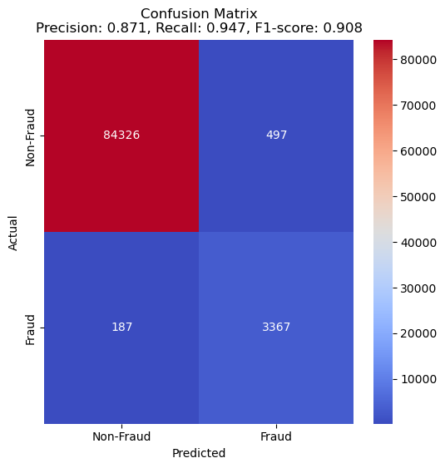
Evaluation by Confusion Matrix
The model successfully classified 83,426 non-frauds and 3,367 frauds correctly. However, there were still 497 false positives (non-frauds that were incorrectly classified as fraud) and 187 false negatives (frauds that were missed).
With a precision of 0.871, a recall of 0.947, and an F1-score of 0.908, the model has a good balance between accuracy and fraud detection.

Slide 32
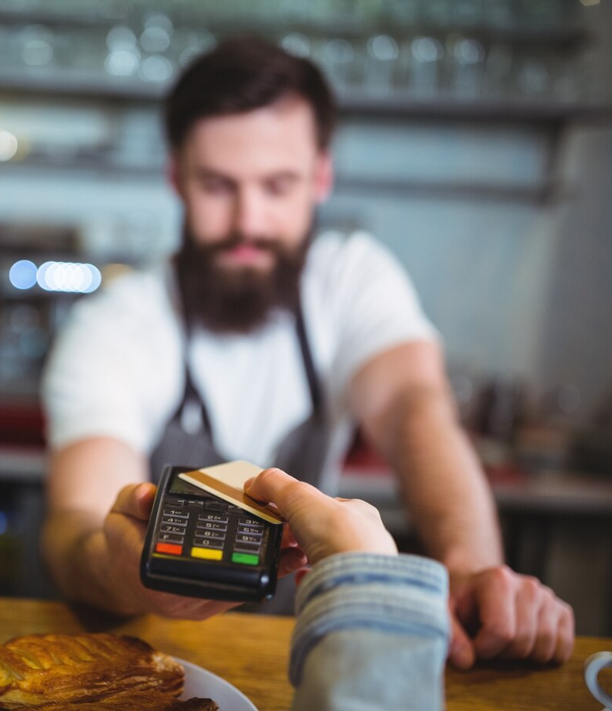
Data
Visualization

Slide 33
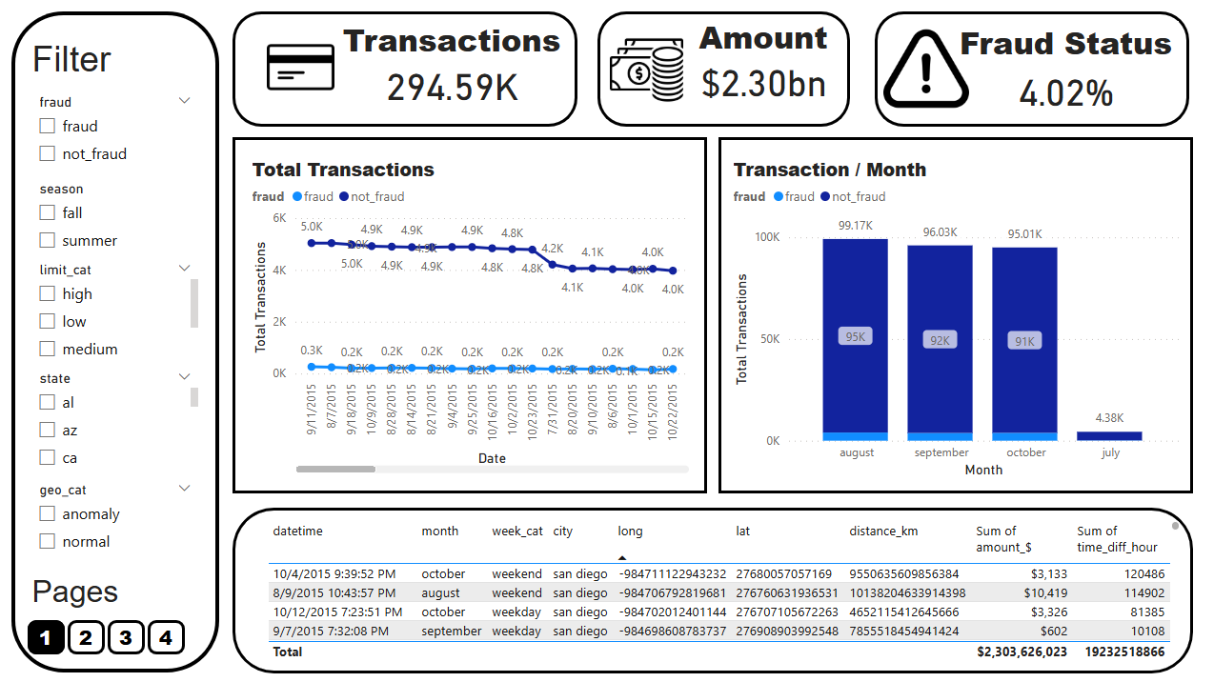
Cab Dashboard

Slide 34

Data Insight

Slide 35

Based on Key Indicators
Factors that determine whether a transaction is fraudulent include:
Number of duplicate transactions: The more duplicate transactions there are, the more likely it is that the transaction is occurring.
Transaction duration: Unusual time taken to send a transaction can be an indication of suspicious activity.
Geographic location of the transaction: Significant differences in location from normal transaction patterns can be a sign of potential fraud.
Speed ​​of transaction: Transactions that occur in a very short time compared to normal patterns can be toxic.
Large transaction amounts: Transactions with values ​​that are much larger than average can be an indication of fraud.

Slide 36

Based on Region
Areas with high population density often have large transaction volumes, including credit card usage, which is an opportunity for fraudsters to commit fraud. The density and number of transactions create loopholes for fraudulent practices that are difficult to detect.
Therefore, optimal steps are needed to detect fraudulent transactions. The manual process is time-consuming, so an automated system that analyzes transactions in real-time is needed to detect suspicious activity more efficiently.

Slide 37

Based on Models
Fraud detection model performed very well in distinguishing fraudulent and non-fraudulent transactions, as indicated by an AP Score of 0.960 and an AUC of 0.999. The model showed an optimal balance between precision and recall, with stable detection capabilities across thresholds.
Although the model successfully classified most transactions correctly, there were still false positives and false negatives that needed to be minimized. To further improve accuracy, optimization can be carried out by adjusting the threshold or applying cost-sensitive learning to better suit the model's business needs and operational risks.

Slide 38




If you want to collaborate
Profile (Clickable)
Email (Clickable)
Project (Clickable)

Slide 39


